Slide 1
Simple Interest & Compound Interest
Basics

Slide 2
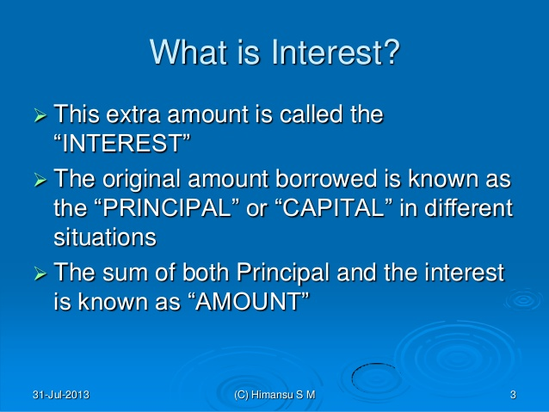
INTEREST

Slide 3
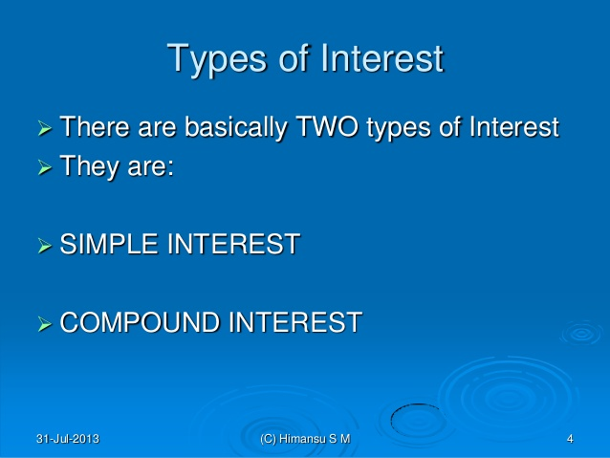
TYPES

Slide 4
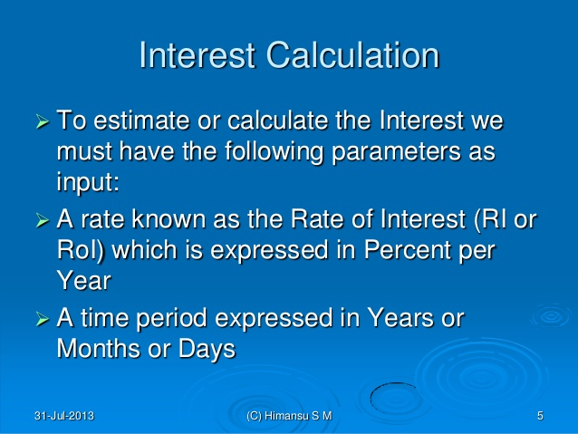

Slide 5
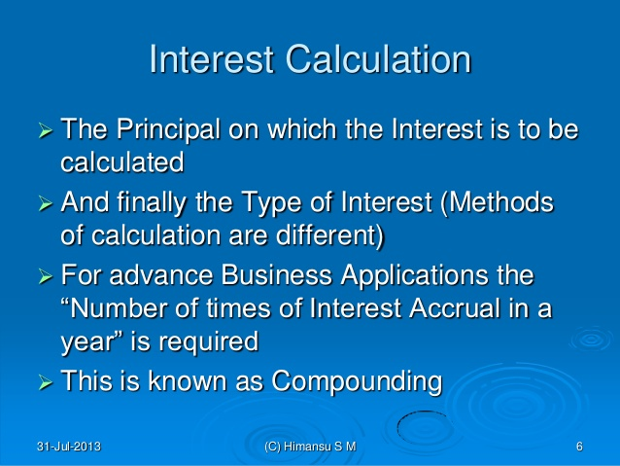

Slide 6
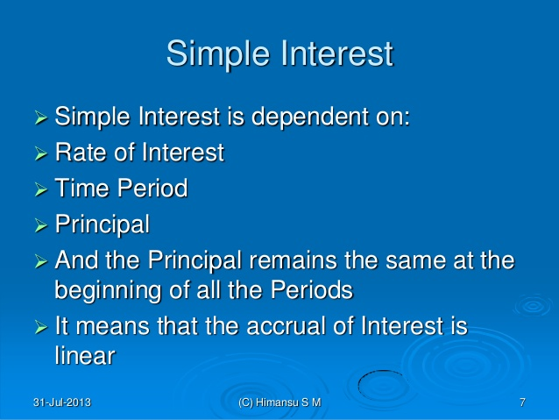

Slide 7
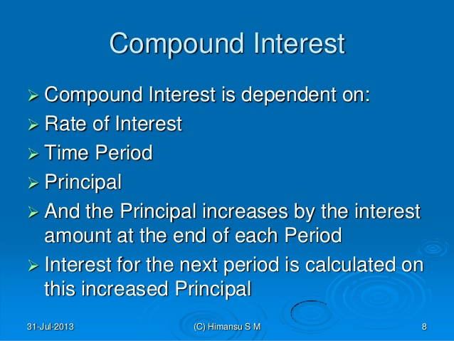

Slide 8
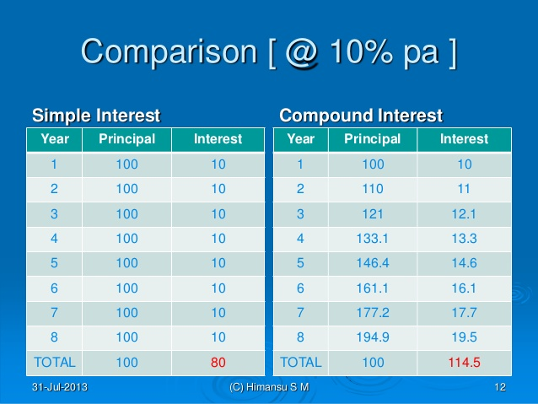

Slide 9
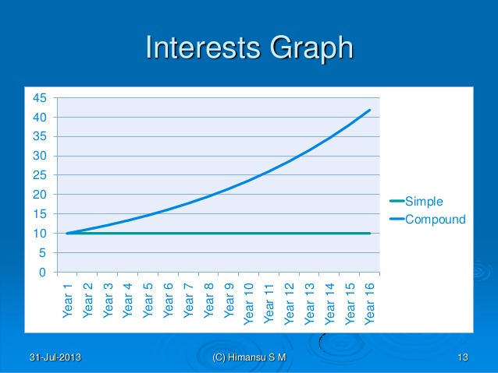

Slide 10
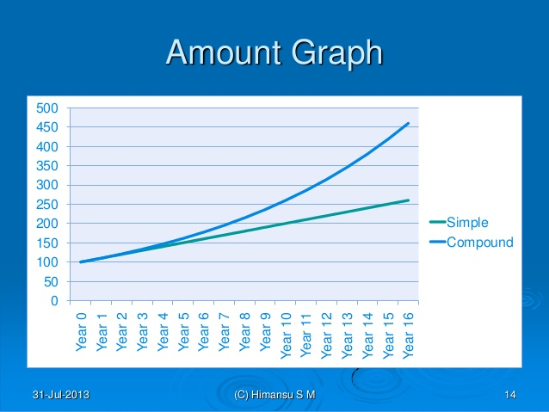

Slide 11
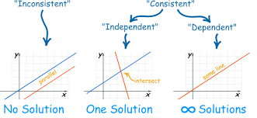
GRAPH

Slide 12
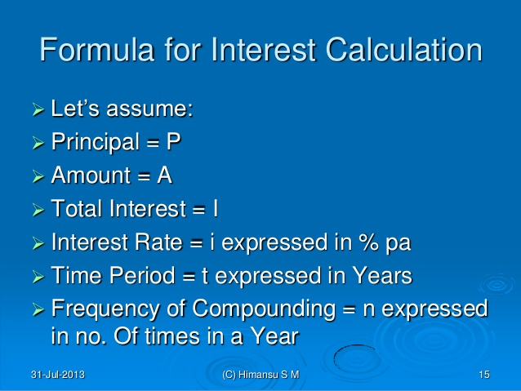

Slide 13
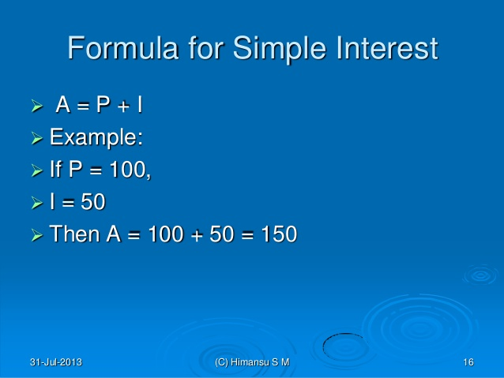

Slide 14
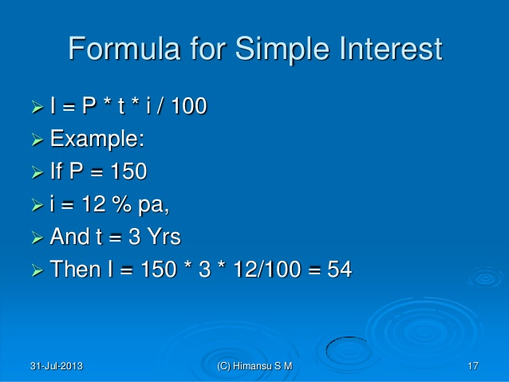
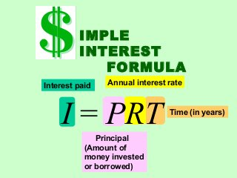

Slide 15
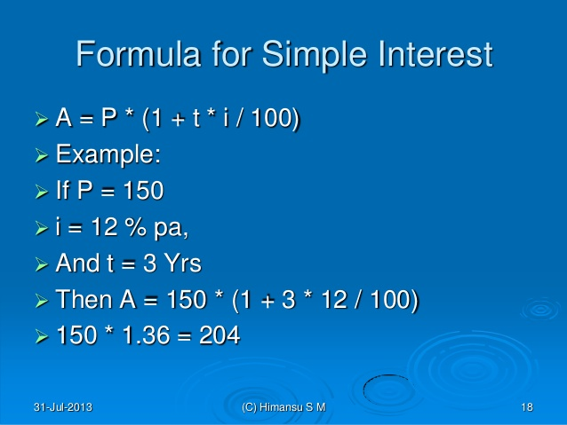

Slide 16
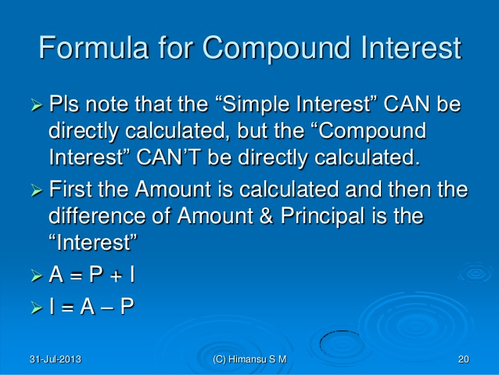

Slide 17
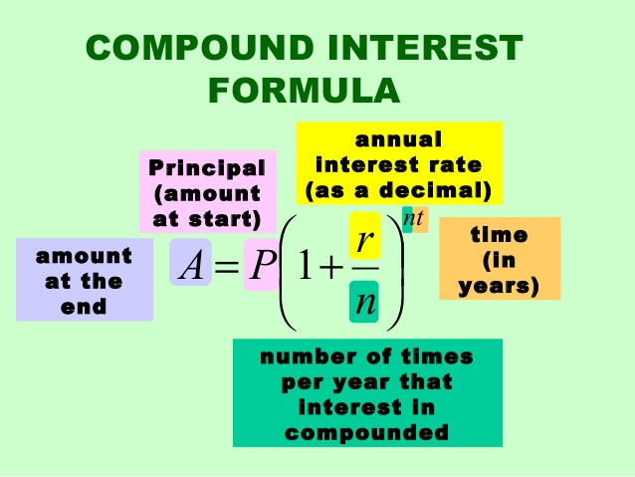


Slide 18
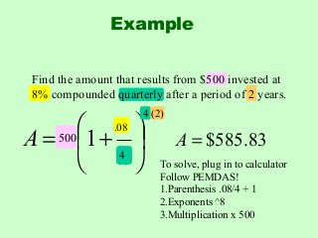

Slide 19
DIFFERENCE B/W CI & SI

Slide 20
What will be the simple interest on Rs. 80,000 at 16(2/3) % per annum for 9 months? a. 8,000 b. 9,000 c. 10,000 d. 11,000

Slide 21
Find the simple interest on Rs. 5000 at 6 % per annum for the period from 5th Feb to 19th April, 2015. a. Rs. 40 b. Rs. 50 c. Rs. 60 d. Rs. 70

Slide 22
Suresh borrows Rs. 10,000 for 2 years at 4 % p.a. simple interest. He lends it to Ramesh at 6 % p.a. for 2 years. Find his gain in this transaction per year. a. Rs. 150 b. Rs. 200 c. Rs. 400 d. Rs. 450

Slide 23
At what rate percent per annum will sum of money double in 20 years? a. 1.2 % b. 2 % c. 4 % d. 5 %

Slide 24
A sum of Rs. 12,000 amounts to Rs. 15,000 in 4 years at the rate of simple interest. Find the rate of interest. a. 6.25 % b. 4.25 % c. 5.9 % d. 5 %

Slide 25
Nikhil borrowed some money at the rate of interest 5 % p.a. for first 2 years, 8 % p.a. for next 5 years and 10 % p.a. for a period beyond 7 years. If he pays total interest of Rs. 8000 at the end of 10 years, then find the money Nikhil borrowed. a. Rs. 40,000 b. Rs. 35,000 c. Rs. 25,000 d. Rs. 10,000

Slide 26
A sum was put at simple interest at a certain rate for 2 years. Had it been put at 2 % higher rate, it would have fetched Rs. 400 more. Find the sum. a. 8000 b. 9000 c. 10000 d. 12000

Slide 27
Find the compound interest on Rs. 5000 for 9 months at 6% per annum, if the interest is reckoned quarterly. a. Rs. 218.98 b. Rs. 228.39 c. Rs. 250.69 d. Rs. 356.50

Slide 28
Find the compound interest on Rs. 20,000 in 2 years at 4 % per annum, the interest being compounded half-yearly. a. Rs. 1648.64 b. Rs. 1596.32 c. Rs. 14826.56 d. Rs. 11563.99

Slide 29
Find compound interest on Rs. 8500 at 4 % per annum for 2 years, compounded annually. a. Rs. 752.6 b. Rs. 693.6 c. Rs. 553.6 d. Rs. 593.6

Slide 30
The difference between C.I. and S.I. on a certain sum at 10 % per annum for 2 years is Rs. 530. Find the sum. a. 53000 b. 57500 c. 69800 d. 28090

Slide 31
The compound interest on a certain sum at 50/3 % for 3 years is Rs. 127. Find simple interest on same sum for same period and rate. a. Rs. 205 b. Rs. 175 c. Rs. 152 d. Rs. 108

Slide 32
The difference between C.I. and S.I. accrued on an amount of Rs. 20,000 in 2 years was Rs. 392. Find the rate of interest per annum. a. 11.5 % b. 13 % c. 14 % d. 12 %

Slide 34
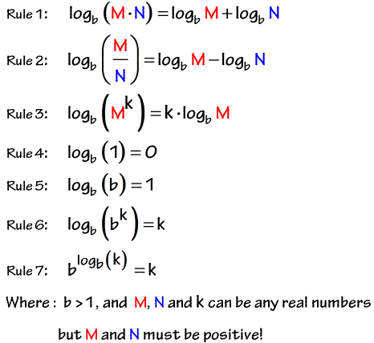

Slide 35
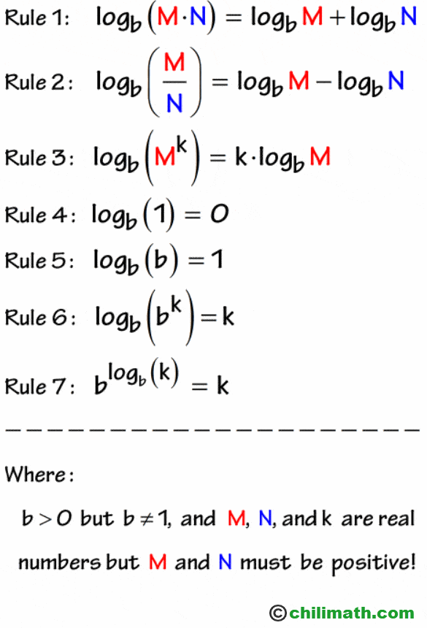

Slide 36
